Slide 1


Intermediate Python
Advanced Module Concepts

Slide 2
Advanced Module Concepts – Overview
Designing clean, reusable modules
Controlling what modules expose
Managing execution vs import
Using aliases for clarity
Advanced import techniques
Notes:
Explain that this session focuses on best practices and advanced behaviors rather than basic syntax.

Slide 3
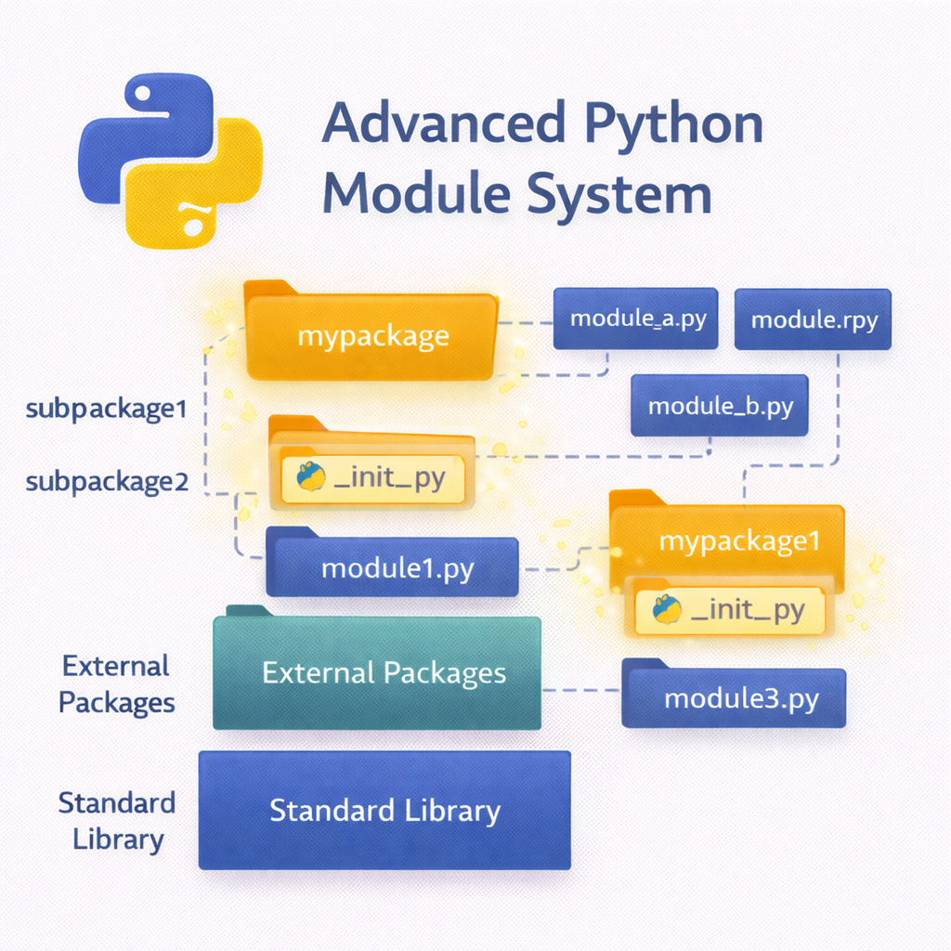

Slide 4
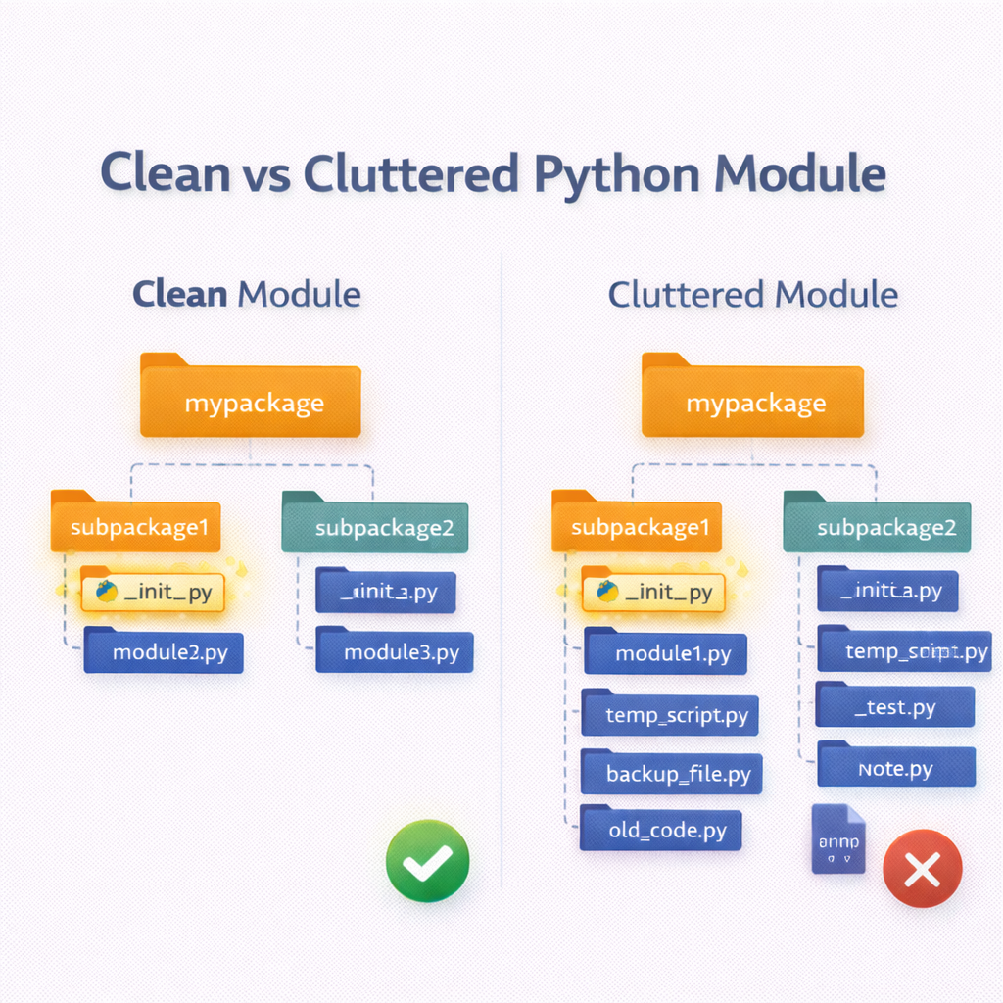
Module Design Principles
One responsibility per module
Keep public API small
Avoid side effects on import
Write reusable, testable code
Document module behavior
Notes:
Emphasize readability and maintainability. Mention that good module design reduces bugs and makes testing easier.

Slide 5
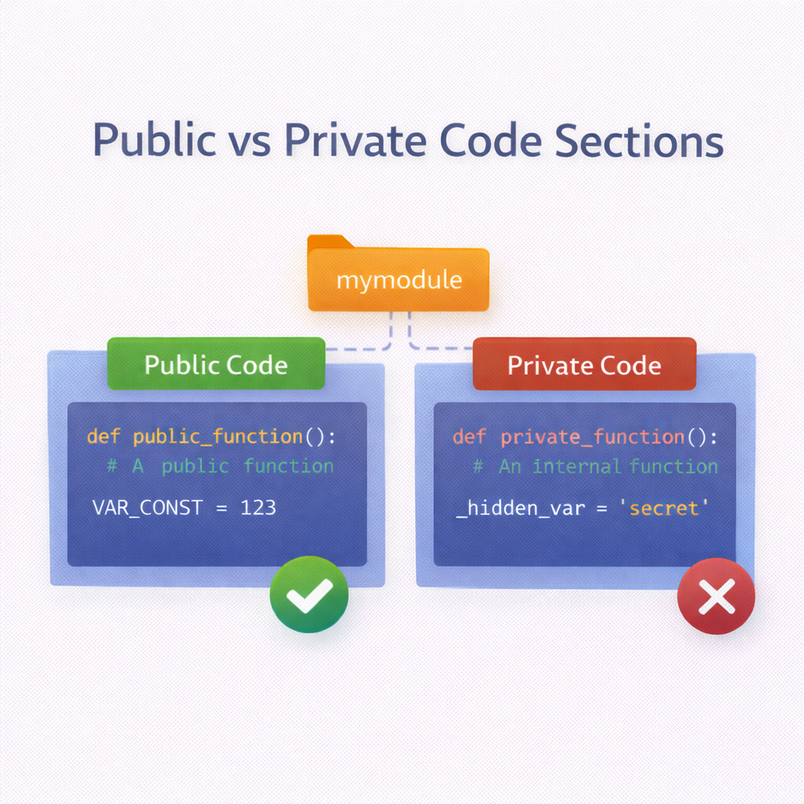
Data Hiding (_X, __all__)
_name signals internal use
Not truly private, but a convention
__all__ controls wildcard imports
Helps define public API
Improves maintainability
Notes:
Explain that Python relies on conventions, not strict access control. Show how from module import * behaves differently.

Slide 6
Code Example
# mymodule.py
__all__ = ["public_func"]
def public_func():
pass
def _internal_func():
pass

Slide 7
__name__ == "__main__"
Distinguishes script vs module
Prevents code running on import
Enables reusable modules
Common Python pattern
Essential for larger projects
Notes:
Stress this as a must-know pattern. Demonstrate by importing the file vs running it directly.

Slide 8
Code Example
def main():
print("Running directly")
if __name__ == "__main__":
main()

Slide 9
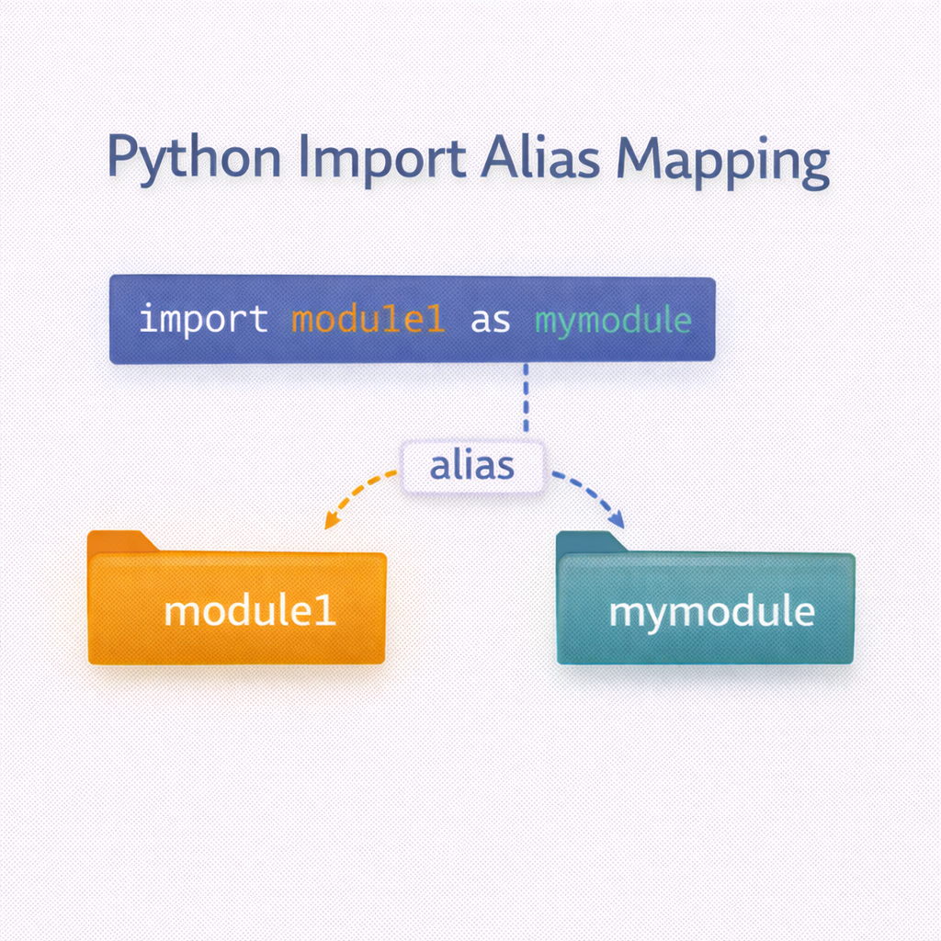
Alias Usage
Shortens long module names
Improves readability
Avoids naming conflicts
Common in scientific code
Explicit but concise
Notes:
Explain when aliases are helpful vs when they hurt readability. Mention standard aliases like np, pd.

Slide 10
Code Example
import numpy as np
import math as m
print(m.sqrt(16))

Slide 11
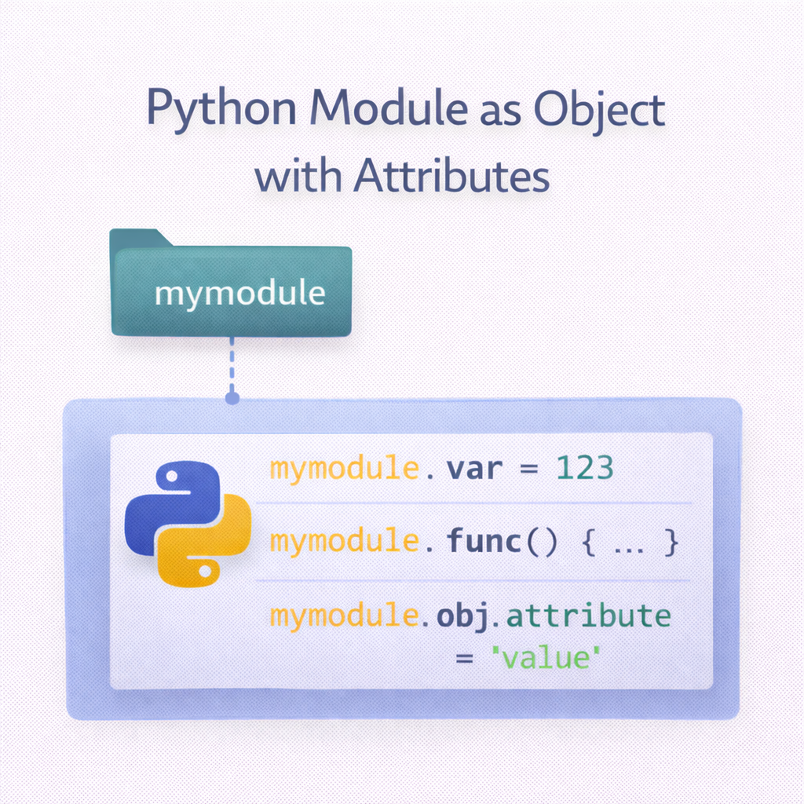
Modules as Objects
Code Example
import math
print(type(math))
print(math.__dict__.keys())
Modules are first-class objects
Stored in sys.modules
Have attributes and state
Can be passed around
Introspectable at runtime
Notes:
This helps learners understand dynamic imports, reloading, and monkey patching.

Slide 12
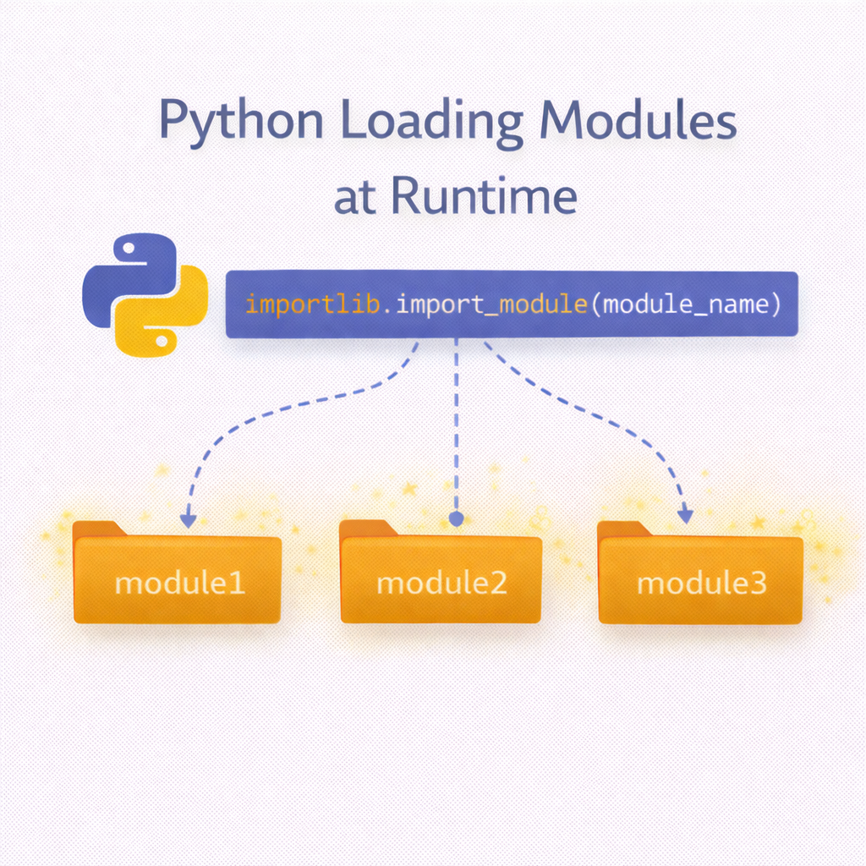
Dynamic Imports
Import modules at runtime
Use importlib
Useful for plugins
Adds flexibility
Reduces startup cost
Notes:
Explain real-world use cases like plugin systems and optional dependencies.

Slide 13
Code Example
import importlib
module = importlib.import_module("math")
print(module.sqrt(25))

Slide 14
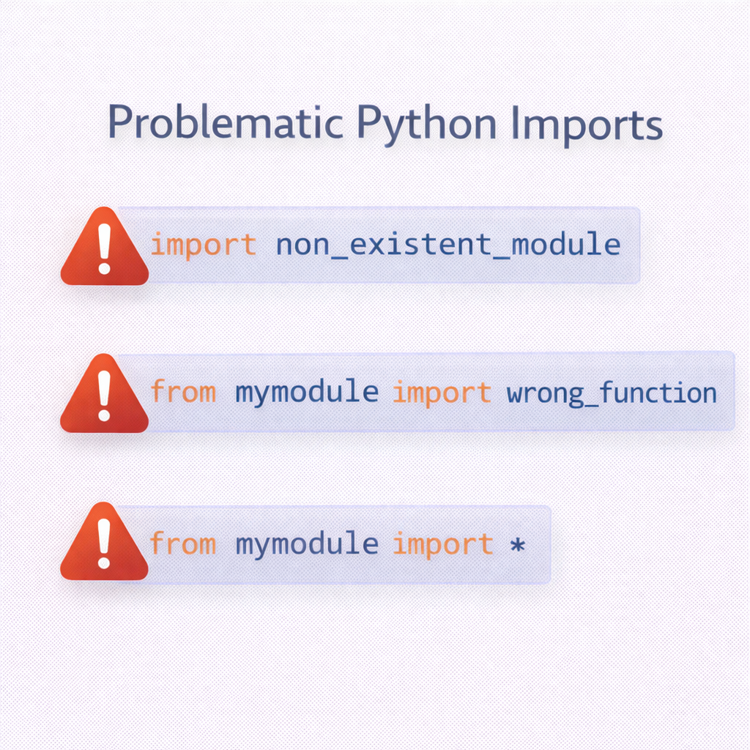
Module Gotchas
Circular imports
Shadowing standard modules
Code executing on import
Misusing wildcard imports
Path-related errors
Notes:
Share real debugging stories. Emphasize prevention through structure and naming.

Slide 15
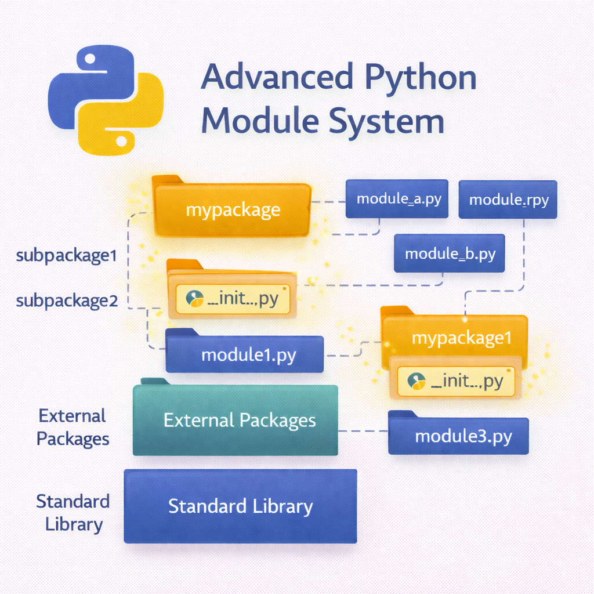
Best Practices Summary
Keep modules small and focused
Use explicit imports
Protect executable code
Follow naming conventions
Test imports early
Notes:
Reinforce habits that scale from small scripts to large systems.

Slide 16
Session Wrap-Up
Modules define program structure
Python favors conventions
Advanced imports enable flexibility
Good design prevents bugs
Foundation for packages & apps
Notes:
Position this session as the bridge to frameworks, packaging, and professional Python development

